Slide 1



IronPython… OMFG v2.0 An introduction to BYOI Payloads (Bring Your Own Interpreter)
© Black Hills Information Security
@BHInfoSecurity

Slide 2
Agenda
Motivation
Some Key .NET Framework Concepts
Embedding Interpreters/Engines
Some BYOI Payload Examples & Demos
Weaponizing .NET Scripting Languages in under 2 Min
SILENTTRINITY
Detection
Q&A
© Black Hills Information Security
@BHInfoSecurity

Slide 3
Whoami
Marcello (@byt3bl33d3r)
Work for BlackHills InfoSec
I got some sparkly pieces of paper (a.k.a Certs)
I’ve written some Open-Source stuff over the years
https://www.github.com/byt3bl33d3r

Slide 4
Motivation
Offensive PowerShell tradecraft == Zombie
C# tooling migrations has operational disadvantages
Red Teams ❤️ dynamic/scripting languages
I like developing ”weird” tools & tradecraft
”The weirder you get the harder you are to detect”
© Black Hills Information Security
@BHInfoSecurity

Slide 5
WTH is a .NET Assembly??
© Black Hills Information Security
@BHInfoSecurity

Slide 6
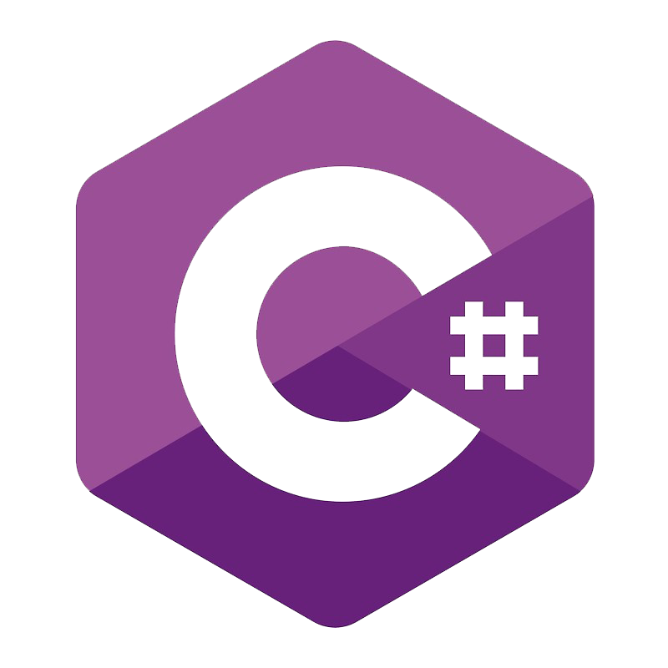
WTH is a .NET Assembly?
Both .NET assemblies !
© Black Hills Information Security
@BHInfoSecurity

Slide 7
WTH is a .NET Assembly?
.NET assemblies != Native EXEs/DLLs
© Black Hills Information Security
@BHInfoSecurity

Slide 8
.NET Languages
© Black Hills Information Security
@BHInfoSecurity

Slide 9

.NET Languages
F#
© Black Hills Information Security
@BHInfoSecurity

Slide 10
Assembly.Load()
© Black Hills Information Security
@BHInfoSecurity

Slide 11
Assembly.Load()
Accepts a byte array!
Equivalent of
Reflective DLL/PE injection!!
© Black Hills Information Security
@BHInfoSecurity

Slide 12
Go deeper!
A lot less defenses here!
All the defenses are here!
F#
© Black Hills Information Security
@BHInfoSecurity

Slide 13
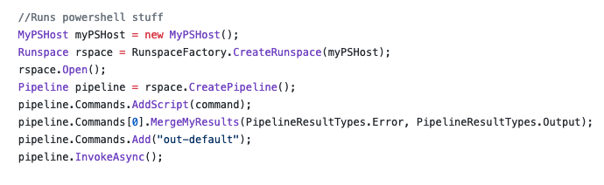
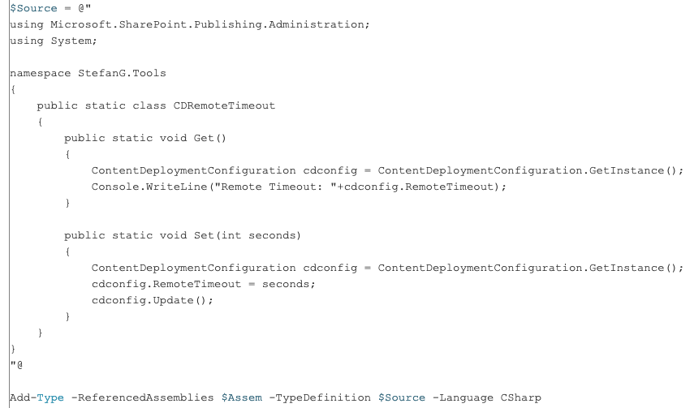
Embedding Interpreters/Engines
https://github.com/fullmetalcache/PowerLine
C# Code
© Black Hills Information Security
@BHInfoSecurity
https://blogs.technet.microsoft.com/stefan_gossner/2010/05/07/using-csharp-c-code-in-powershell-scripts/

Slide 14
Common Problems when Embedding Interpreters
Embedded language is going to require .NET > v4.0
The embedded language is going to need some DLLs to run (.NET assemblies)
The required assemblies are (usually) not installed by default
Depending on the “host” language you’re going to need to resolve the needed DLLs on runtime before you start the actual Interpreter up
Because of Assembly.Load() we can do load them in-memory without touching disk
© Black Hills Information Security
@BHInfoSecurity

Slide 15
Loading the Required Assemblies
Which method you use depends heavily on the language you’re embedding into:
Passing the raw bytes of the assemblies to Assembly.Load() to load them into the current AppDomain
Hooking the AppDomain.Assembly.Resolve Event
Using Module Initializers
© Black Hills Information Security
@BHInfoSecurity

Slide 16

BYOI Payloads

Slide 17
IronPython!
https://ironpython.net/
https://github.com/IronLanguages/ironpython2
Implementation of Python on top of the .NET framework
The module used to call native methods breaks when the language is embedded ☹
© Black Hills Information Security
@BHInfoSecurity

Slide 18
Embedding IronPython in C#/Powershell
https://github.com/byt3bl33d3r/OffensiveDLR
SharpSnek.cs & Invoke-Ironpython.ps1
IronPython requires 4 .NET assemblies to run:
IronPython.dll
IronPython.Modules.dll
Microsoft.Scripting.dll
Microsoft.Dynamic.dll
© Black Hills Information Security
@BHInfoSecurity

Slide 19
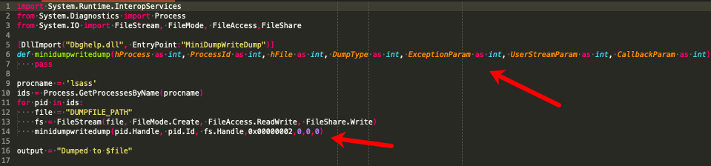
Boolang… The real MVP
https://github.com/boo-lang/boo
Love Child between Python and C#
Syntax heavily inspired by Python
Can call Native Functions!!!! (no calls to csc.exe, everything is truly in memory!)
© Black Hills Information Security
@BHInfoSecurity

Slide 20
Embedding Boo In C#/PowerShell
https://github.com/byt3bl33d3r/OffensiveDLR
runBoo.cs & Invoke-Jumpscare.ps1
Boo requires 3 .NET assemblies to run:
BooLang.dll
BooLang.Compiler.dll
BooLang.Parser.dll
PowerShell:
We just call Assembly.Load() on the DLLs before initializing the Interpreter
C#:
We hook the Assembly.Resolve event

Slide 21
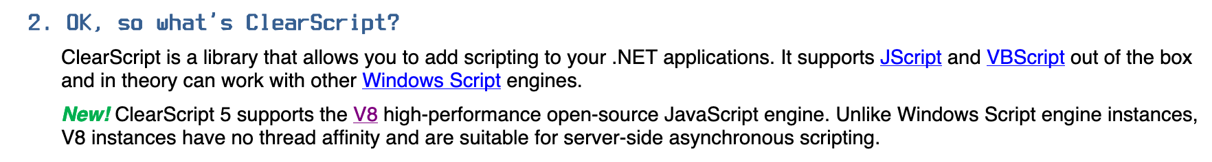
ClearScript ??
https://github.com/microsoft/ClearScript
https://microsoft.github.io/ClearScript/Tutorial/FAQtorial
© Black Hills Information Security
@BHInfoSecurity

Slide 22
Awesome ClearScript Facts
It’s an official Microsoft project
It’s Jscript/VBScript implementation does not seem to go through WSH (Still more research to be done)
Allows you to directly expose the .NET CLR to it’s built-in Jscript/VBScript implementation
© Black Hills Information Security
@BHInfoSecurity

Slide 23
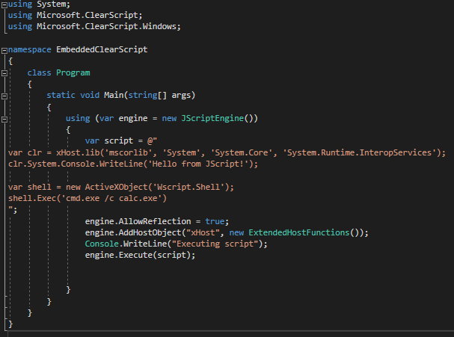
Embedding ClearScript in C#/PowerShell

Slide 24
Embedding ClearScript in C#/PowerShell
https://github.com/byt3bl33d3r/OffensiveDLR
Invoke-ClearScript.ps1
If you only want to run Jscript/VBScript you only need 1 Assembly (ClearScript.dll)
If you want to run the V8 Javascript engine you need 3-4 more

Slide 25
.NET Alchemy Recipes (Choose your favorite language!)
https://github.com/xanathar/moonsharp (Lua)
https://github.com/NLua/NLua (Lua)
https://github.com/sebastienros/jint (JavaScript)
https://github.com/RyanLamansky/dotnet-webassembly (WebAssembly)
https://github.com/microsoft/ClearScript (JScript, VBScript & JavaScript)
https://github.com/IronLanguages/ironpython2 (Python 2)
https://github.com/IronLanguages/ironpython3 (Python 3, still not ready)
https://github.com/IronLanguages/ironruby (Ruby)
https://github.com/boo-lang/boo (Boolang)
© Black Hills Information Security
@BHInfoSecurity

Slide 26
Bonus Round (Standalone .NET Language Compilers)
If you use the standalone compilers to compile your scripts, the executable that it generates will run everywhere regardless of the .NET version
This is probably the easiest way to weaponize third-party .NET scripting languages quickly
The resulting binary/DLL is a .NET assembly
© Black Hills Information Security
@BHInfoSecurity

Slide 27
DEMO!
Weaponizing Boolang scripts in 2 min or less
© Black Hills Information Security
@BHInfoSecurity

Slide 28
https://github.com/byt3bl33d3r/SILENTTRINITY

Slide 29
v0.0.1 v0.1.0
From Beerware to Alpha!
Encrypted C2 comms & staging!
Boolang Support
CLI Tab completes all the things!
Customize the check-in interval of the sessions using the sleep command
There’s now a help menu option
© Black Hills Information Security
@BHInfoSecurity

Slide 30
Detection
© Black Hills Information Security
@BHInfoSecurity

Slide 31
Detection
Thank you Ryan Cobb!
@cobbr_io
.NET 4.8 has AMSI integration
CollectDotNetEvents.ps1 by @mattifestation
(https://gist.github.com/mattifestation/444323cb669e4747373833c5529b29fb)
krabsETW (https://github.com/Microsoft/krabsetw)
SilkETW (https://github.com/fireeye/SilkETW)
ModuleMonitor (https://github.com/TheWover/ModuleMonitor)
Luke Jenning at BlueHat v18 || Memory Resident Implants Code injection is alive and well
https://www.countercept.com/blog/hunting-for-silenttrinity/
© Black Hills Information Security
@BHInfoSecurity

Slide 32
Detection
No image backing
© Black Hills Information Security
@BHInfoSecurity

Slide 33
Coming Soon! (v0.2.0)
Complete rewrite to have a teamserver architecture (ala CStrike)
A lot more comms (already have DoH & WMI somewhat working)
Long Term Goal: CrackMapExec, Red Baron Integration, external c2 tool compatibility (Empire, Metasploit etc...), support for moar languages !
© Black Hills Information Security
@BHInfoSecurity

Slide 34
Q&A
© Black Hills Information Security
@BHInfoSecurity

Slide 35
Marcello (@byt3bl33d3r)
https://github.com/byt3bl33d3r
@BHinfoSecurity
https://www.blackhillsinfosec.com/
SILETTRINITY code is here:
https://github.com/byt3bl33d3r/SILENTTRINITY
Embedded Payload Code:
https://github.com/byt3bl33d3r/OffensiveDLR
© Black Hils Information Security
@BHInfoSecurity

